Slide 1
Housing Analysis
Identifying key factors in home pricing for Mortgage Backed Securities
-John Savage

Slide 2
Overview & Problem Statement
What are some key indicators that can be easily used to evaluate individual homes?
Do these indicators show is there a significant difference in pricing?
By how much on average?

Slide 3
Data Analyzed
Data contained 1,460 sales from January 2005 through July 2010
Categories include number of bedrooms, quality rating of kitchen, and sales pricing
Raw data available here

Slide 4
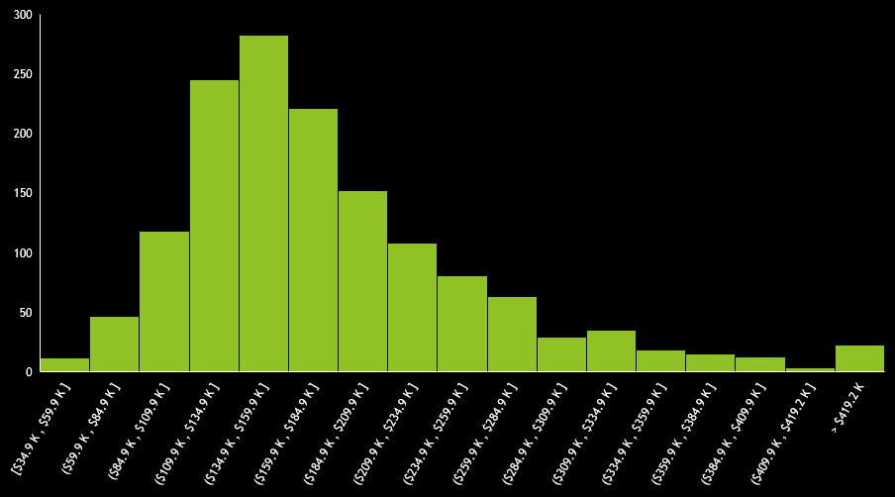
Overview of Data
Sale price is our dependent measurement for our analysis
There is a positive skew meaning more homes are sold below average
There is significant kurtosis, meaning there is a significant number of outliers
The average sale price is $180,921

Slide 5
Hypothesis Examined
The total number of bedrooms (above ground) has no affect on sales price
The rating of kitchens has no affect on sales price

Slide 6
Bedroom Count- 4-8 bedrooms compared to 3-0 bedrooms
There is a statistically significant difference in home sales between 4+ bedroom and 3- bedroom homes:
95% confidence, the average price of homes with 4+ bedrooms is between $26,472 and $54,468 over 3- bedrooms.
Split was decided by rounded average number of bedrooms in data

Slide 7
Kitchen Quality- Good & Excellent compared to Average & Fair & Poor
There is a statistically significant difference in home sales between Good+ quality and Average- quality homes:
95% confidence, the average price of homes with Good+ quality kitchens is between $83,879 and $97,642 over Average- quality kitchens

Slide 8
Recommendations and further actions
Highest sale values can be found with 4+ bedroom homes and homes with Good+ quality kitchens
Perform additional analysis in other market locations to confirm market behavior, if consistent then expansion into other markets becomes feasible with readily available criteria
Depending on whether the MBS is intended to be a Pass-Through or Collateralized Mortgage Obligation another analysis with that in mind would likely produce a more appealing product
Pass-Through packages may benefit more from this current analysis by consisting of few but higher priced items
CMO packages may benefit more from higher volume of homes at a lower price to spread out risk

Slide 9
General Questions
-A leave behind will be made available for more detailed examination.

